Slide 1
Unsupervised ML Clustering Capstone Project Netflix Movies & TV Shows Clustering by
Prajwal M V

Slide 2

Contents:
Introduction
Problem Statement
Data Analysis Steps
Data Preview
Data Summary
EDA
Data Pre-Processing
Clustering
Getting Recommendations
Conclusion

Slide 3

Introduction:
Netflix is a media distribution company. It started with DVD distribution via mail, but has evolved substantially over the course of its existence. Today, Netflix is focused on streaming video. Some of its content is licensed, and some of the content is produced in-house. Netflix originally focused on movies, but today television shows are probably the more common format. Netflix works on a subscription model, where users get unlimited access to content with a paid subscription.

Slide 4

Problem Statement:
This dataset consists of TV shows and movies available on Netflix as of 2019. The dataset is collected from Flixable which is a third-party Netflix search engine.
In 2018, they released an interesting report which shows that the number of TV shows on Netflix has nearly tripled since 2010. The streaming service’s number of movies has decreased by more than 2,000 titles since 2010, while its number of TV shows has nearly tripled. It will be interesting to explore what all other insights can be obtained from the same dataset.
Integrating this dataset with other external datasets such as IMDB ratings, rotten tomatoes can also provide many interesting findings

Slide 5
Data Analysis Steps:
Imported Libraries
In this part, we imported the required libraries NumPy, Pandas, matplotlib, and seaborn, to perform Exploratory Data Analysis and for prediction, we imported the Scikit learn library.
Descriptive Statistics
In this part, we start by looking at descriptive statistic parameters for the dataset. We will use describe() this told mean, median, standard deviation
Missing Value Imputation
We will now check for missing values in our dataset. after checking not existed any missing values, In case there are any missing entries, we will impute them with appropriate values.
Graphical Representation
We will start with Univariate Analysis, bivariate Analysis and conclude with various prediction models helps us predict the Risk.

Slide 6
Dataset Preview:
This dataset consists of TV shows and movies available on Netflix as of 2019. The dataset is collected from Flixable which is a third-party Netflix search engine.
Attributes of each variable:
● show_id : Unique ID for every Movie / TV Show
● type : Identifier - A Movie or TV Show
● title : Title of the Movie / TV Show
● director : Director of the Movie
● cast : Actors involved in the movie / show
● country : Country where the movie / show was produced
● date_added : Date it was added on Netflix
● release_year : Actual Release Year of the movie / show
● rating : TV Rating of the movie / show
● duration : Total Duration - in minutes or number of seasons
● listed_in : Genre
● description: The Summary description

Slide 7
Data Summary :
The dataset contains 12 columns and 7787 rows.
There also exist some null values in our data:
Percentage of null values in director : 30.68%
Percentage of null values in cast : 9.22%
Percentage of null values in country : 6.51%
Percentage of null values in date_added : 0.13%
Percentage of null values in rating : 0.089%
Finally we will do some feature engineering to create few new variables:
Compute year_added, month_added and day_added from date_added after converting it into datetime variable

Slide 8
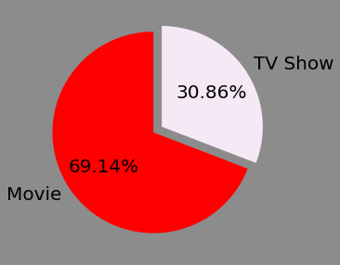
EDA on Netflix Data in Netflix Style
Movies V/S TV Shows:
69.1% of the content available on Netflix are movies; the remaining 30.9% are TV Shows.
Movies uploaded on Netflix are more than twice the TV Shows uploaded.

Slide 9
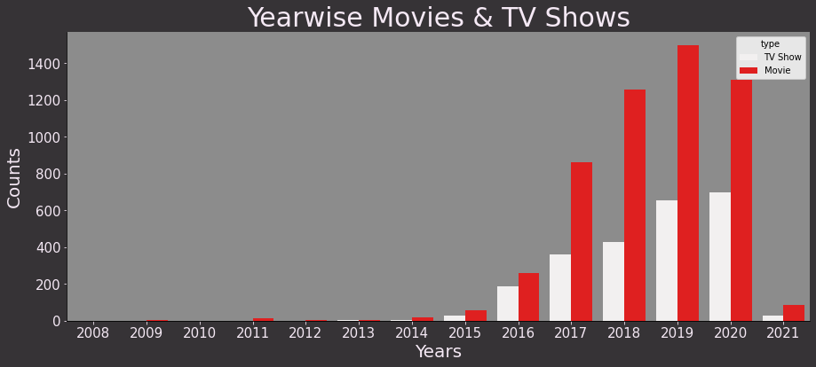
Number of Movies and TV Shows added on Netflix:
On Yearly Basis:
TV shows are increasing continuously.
Movies were increasing continuously but after 2019 there is fall but after 2020 there is sudden fall due to COVID

Slide 10
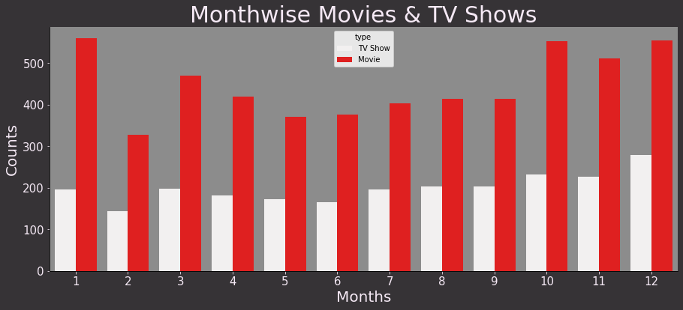
On Monthly Basis:
From October to January, maximum number of movies and TV shows were added.
Possible reason for that is, during this period of time events such as Christmas, New Year and several holidays takes place.

Slide 11
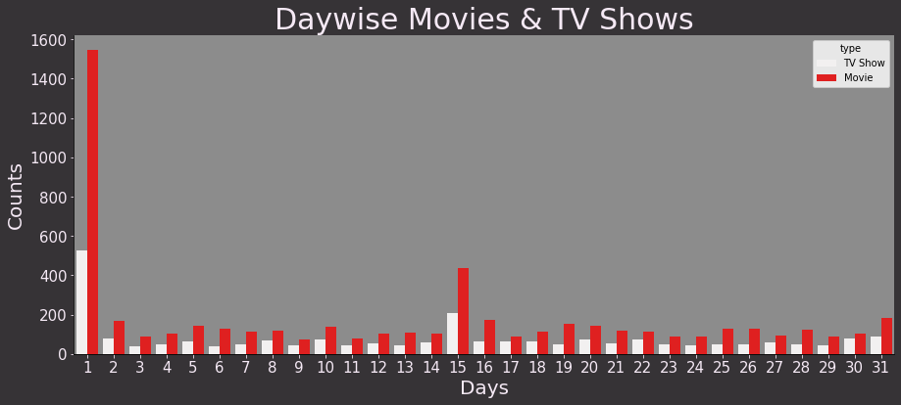
On Daily Basis:
Maximum number of movies and TV shows were either on start of the month or mid of the month.

Slide 12
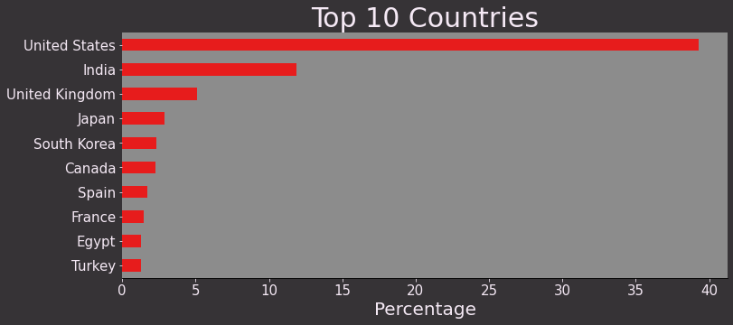
Worldwide Presence:
United State tops in the list of maximum number of movies and TV shows, followed by India, UK and Japan

Slide 13
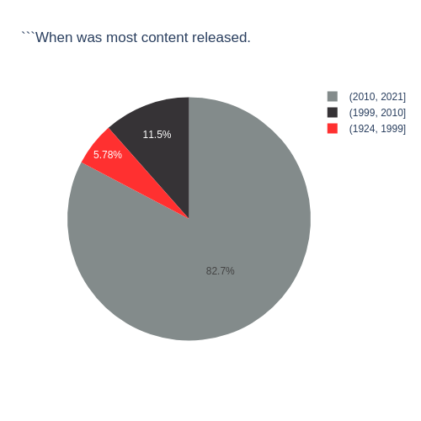
Release year:
82% of the content available was released between 2010 and 2021.
17.28% of the content available was released before 2010.

Slide 14
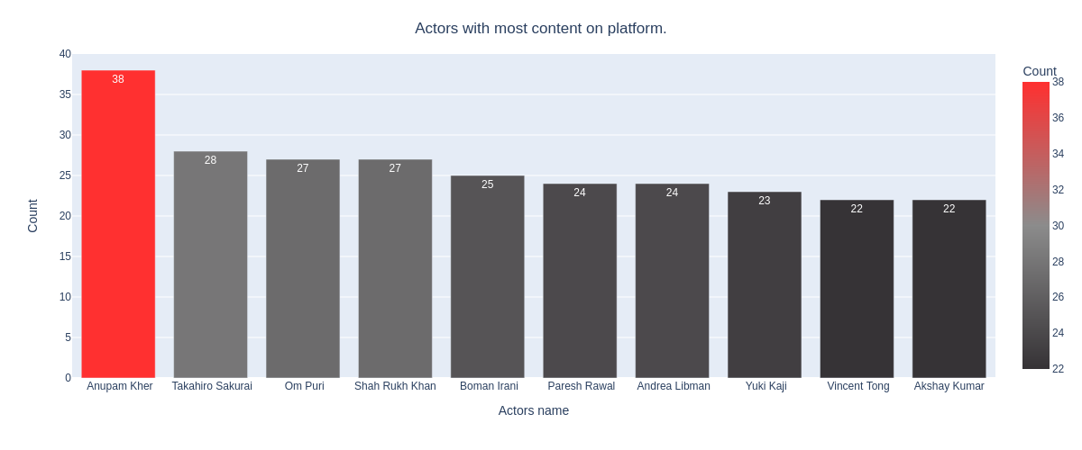
Cast:
Anupam Kher top from the list of casts having maximum number of movies and TV shows.
Happy to see 6 of the actors in the top ten list of most numbers tv shows and movies are from India.

Slide 15
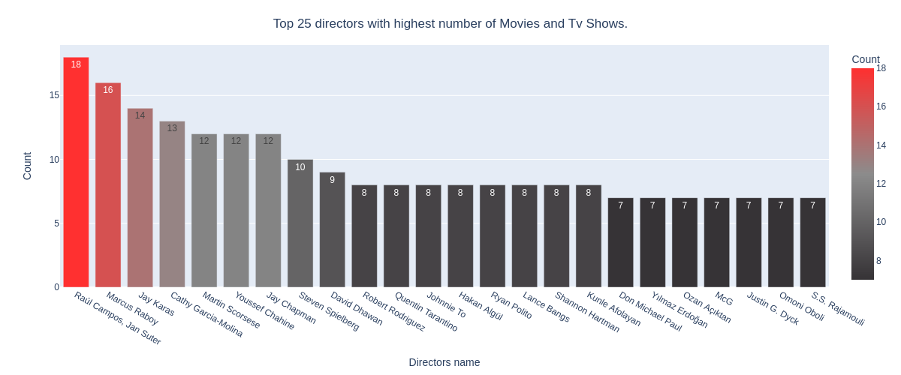
Director:
Raúl Campos, Jan Suter, Marcus Raboy, Jay Karas, Cathy Garcia-Molina, Jay Chapman are the top 5 directors which highest number of movies and TV shows.

Slide 16
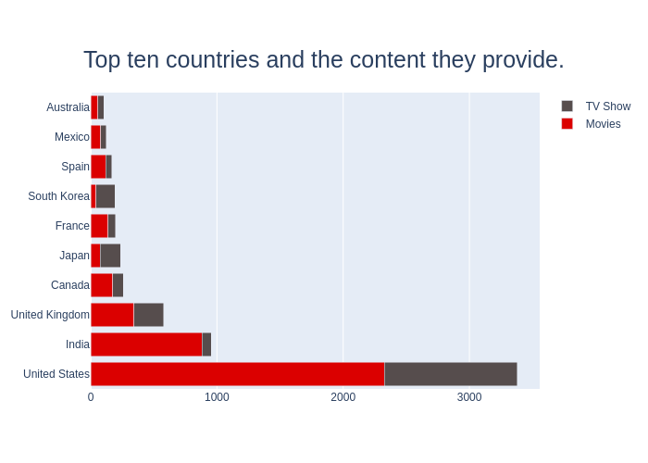
Content vs Country:
The United States is a leading producer of both types of content; this makes sense since Netflix is a US company.
The influence of Bollywood in India explains the type of content available, and perhaps the main focus of this industry is Movies and not TV Shows.
On the other hand, TV Shows are more frequent in South Korea, which explains the KDrama culture nowadays.

Slide 17
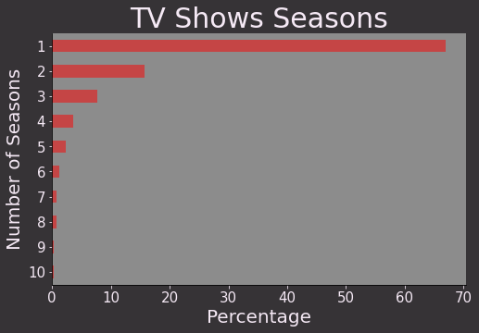
Seasons of TV Shows:
Almost 68% of TV shows consist of single season only.
Most of the TV Shows last for 1 or 2 seasons, it is rare for a show to have more than 5 seasons.

Slide 18
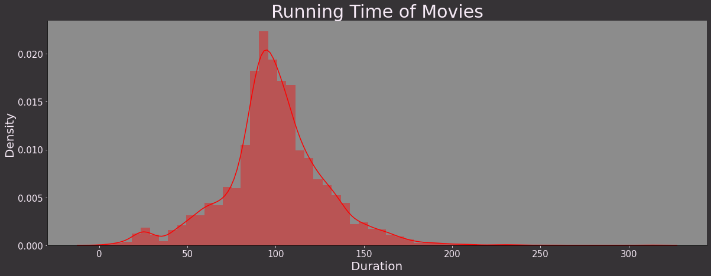
Running Time of Movies:
Most of the TV Shows last for 1 or 2 seasons, it is rare for a show to have more than 5 seasons.
Most of the movies last for 90 to 120 minutes.

Slide 19
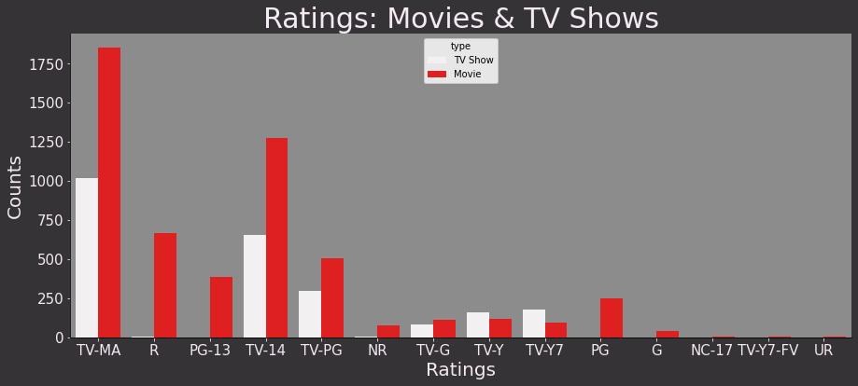
Ratings:
Maximum of the movies as well as TV shows are for matures only.
TV-MA tops the charts, indicating that mature content is more popular on Netflix.
This popularity is followed by TV-14 and TV-PG, which are Shows focused on Teens and Older kids.
Very few titles with a rating NC-17 exist. It can be understood since this type of content is purely for the audience above 17

Slide 20
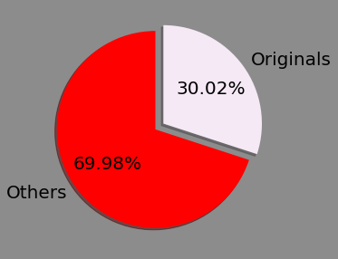
Netflix Originals:
Originals in Movies:
30% movies released on Netflix.
70% movies added on Netflix were released earlier by different mode.
May be after buying rights of old released movies and then adding all the movies on Netflix.

Slide 21
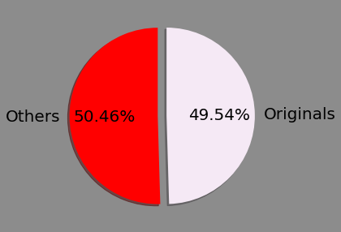
Originals in TV Shows:
Almost 50-50.
50% TV shows originally from Netflix whereas remaining 50% were added after released on different mode.

Slide 22
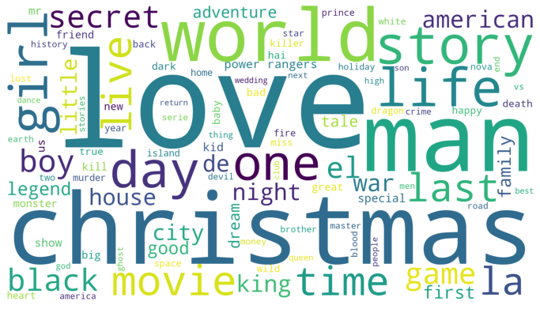
Title:
Most repeated words in title include Christmas, Love, World, Man, and Story.
We saw that most of the movies and tv shows got added during the winters, which tells why Christmas appeared many times in the titles.

Slide 23
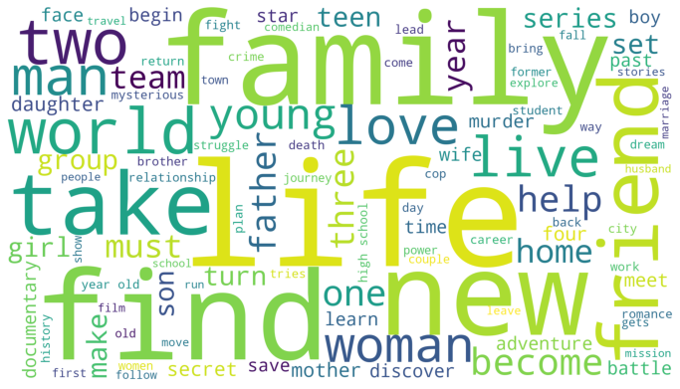
Description:
Most occurring words in the description of the tv shows and movies are Family, Friend, Love, Life, Woman, Man

Slide 24
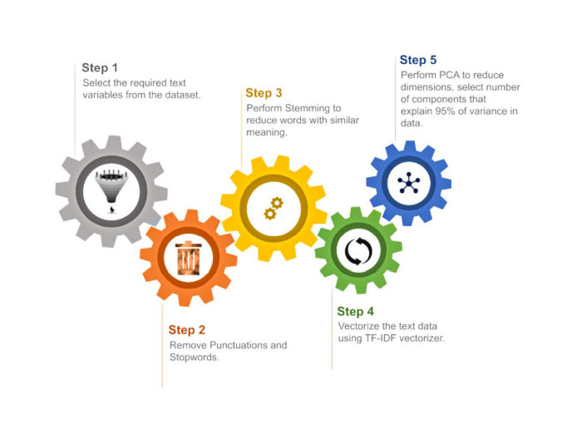
Data Pre-processing for Clustering:

Slide 25
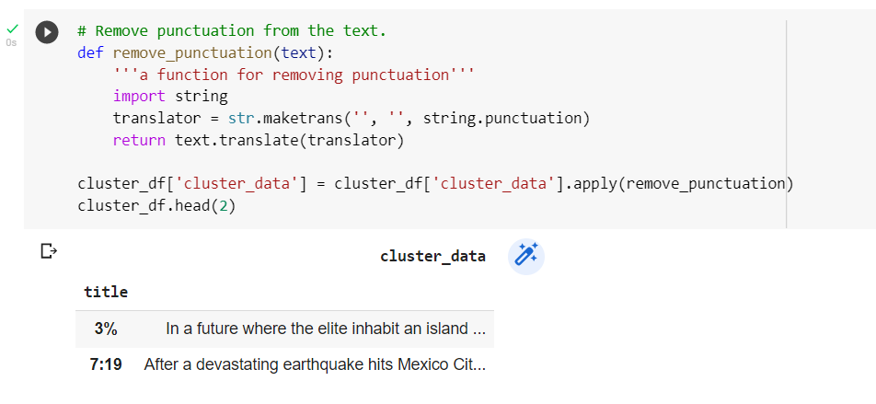
Removing Punctuations:
Punctuations does not carry any meaning clustering.
So, removing punctuations helps to get rid of unhelpful parts of the data, or noise.

Slide 26
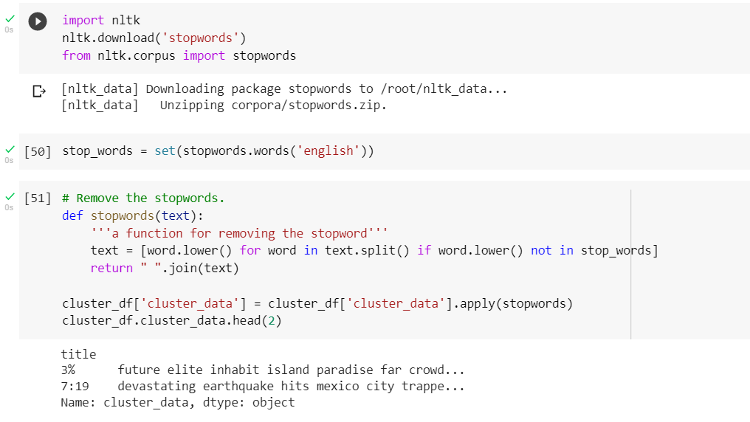
Removing Stop words:
Stop words are basically a set of commonly used words in any language, not just English.
If we remove the words that are very commonly used in a given language, we can focus on the important words instead.

Slide 27
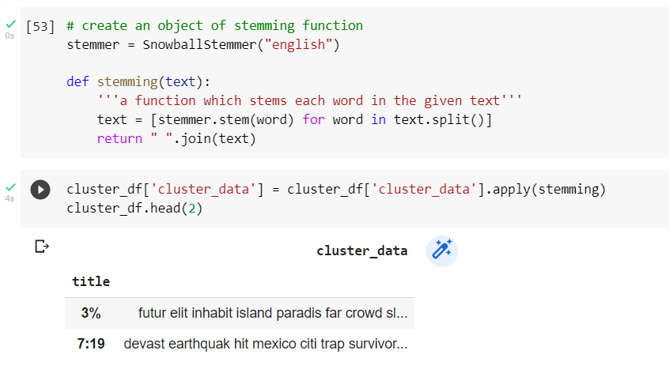
Stemming:
Stemming is the process of removing a part of a word, or reducing a word to its stem or root.
Applying stemming to reduce words to their basic form or stem, which may or may not be a legitimate word in the language

Slide 28
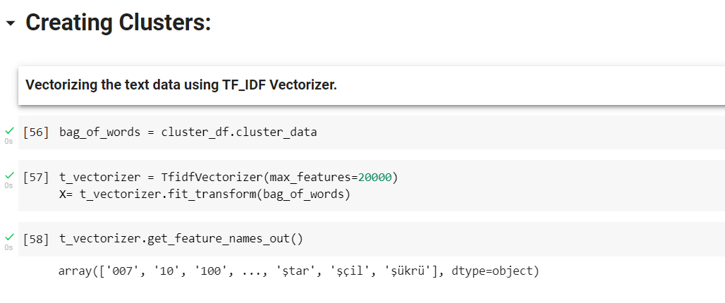
Creating Clusters:
Vectorizing the text data using TF_IDF Vectorizer:
Here we have textual data.
Clustering algorithms cannot understand textual data.
So, we use vectorization technique to convert textual data to numerical vectors

Slide 29
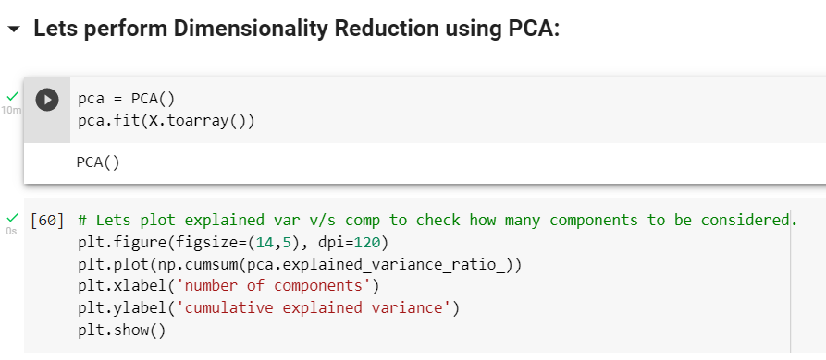
Principal Component Analysis:
Here we perform PCA to reduce dimensions, for select number of component's that explain 95% of Variance in Data .

Slide 30
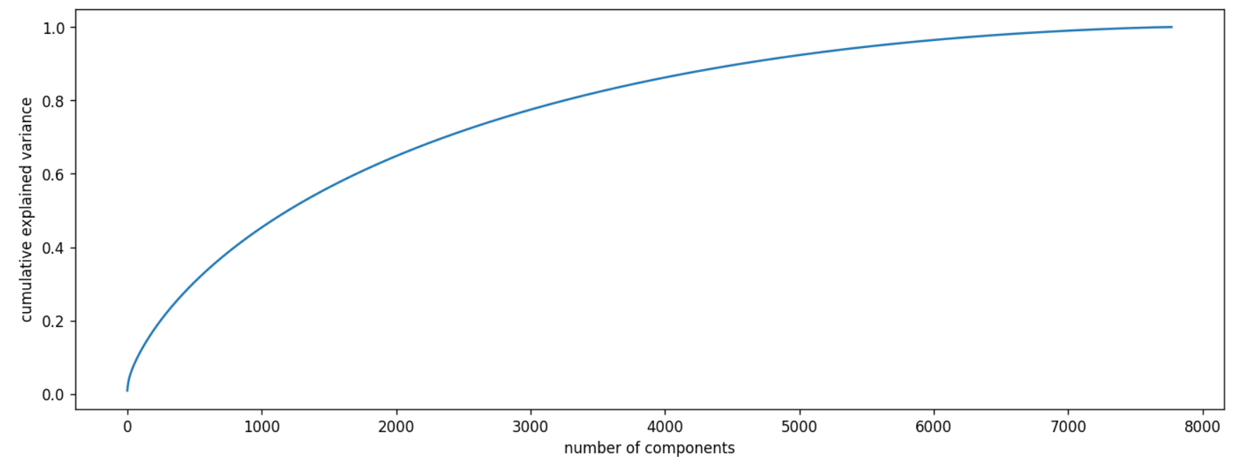
We can see from the above plot almost 95% of the variance can be explained by 5000 components.
Since choosing 5000 could be tricky we will set the value to be 95% in SKLearn.

Slide 31
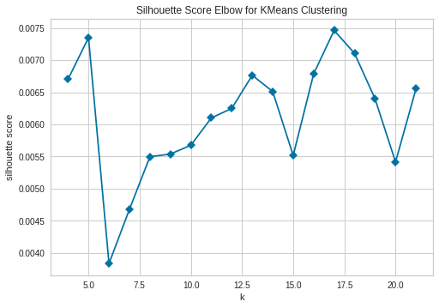
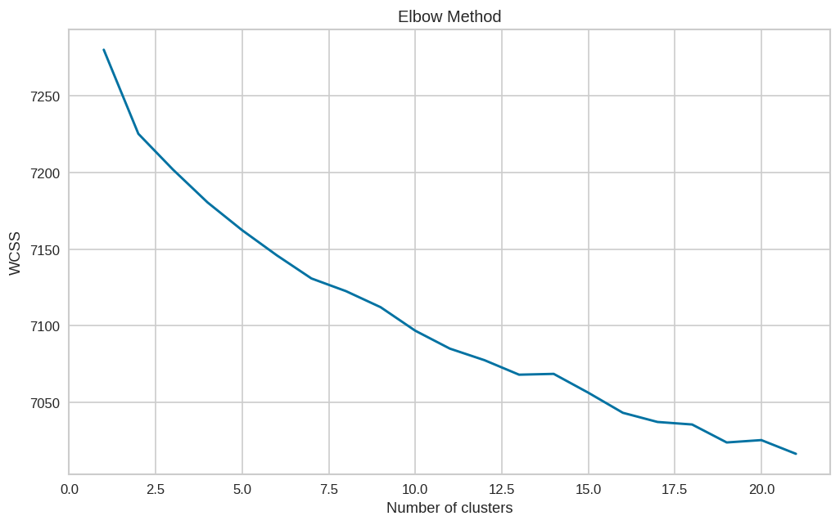
Determining optimal value for k:
Using the Silhouette Score and Elbow Method we select the optimal number of clusters to be 10.

Slide 32
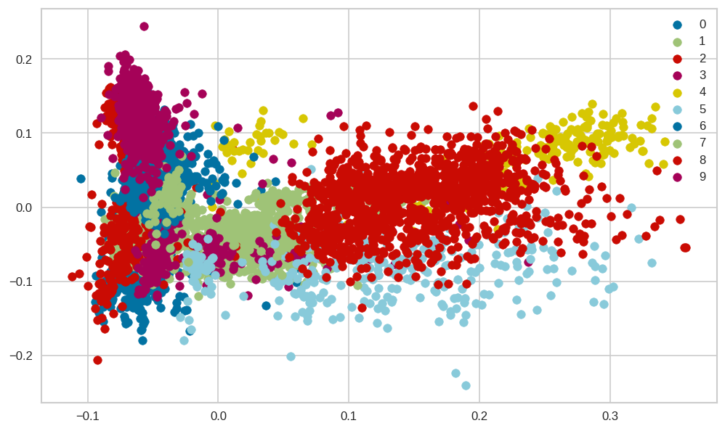
10 Distinct clusters created using kMeans Clustering:
K-means algorithm is an iterative algorithm that tries to partition the dataset into K pre-defined distinct non-overlapping subgroups where each data point belongs to only one group.
The numbers 0 to 9 represent 10-distinct clusters formed by K-means clustering.
Each cluster contains data points similar to those in the same groups but varies from other groups

Slide 33
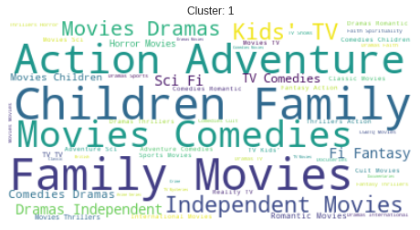
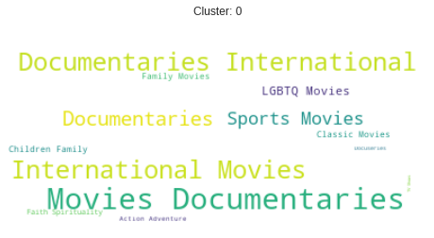
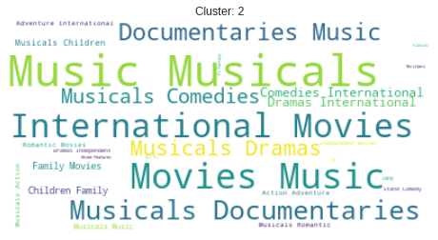
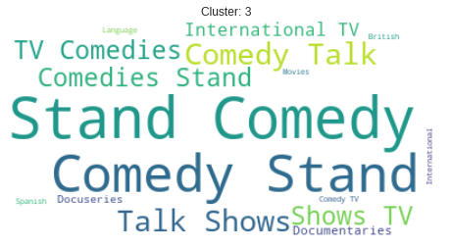
Representing each cluster using world cloud:
Cluster 0: Documentaries.
Cluster 1: Family and Children Movies
Cluster 2: Musical Movies and Documentaries
Cluster 3: Stand Up Comedy and Comedy Shows.

Slide 34
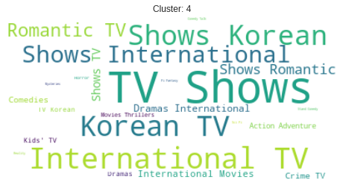
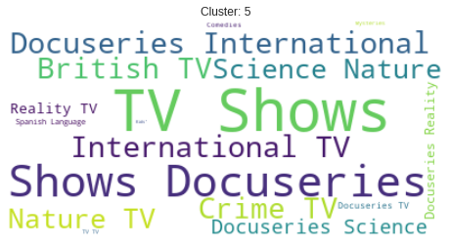
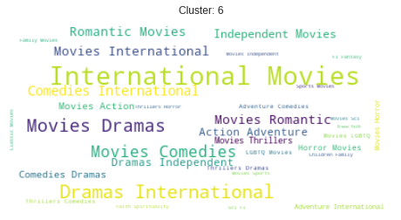
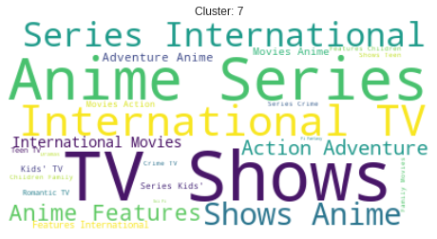
Cluster 4: Korean and Romantic TV Shows. Cluster 5: Science, Nature, Reality, Crime TV Shows and Docuseries.
Cluster 6: International Movies. Cluster 7: Anime Series and TV Shows.

Slide 35
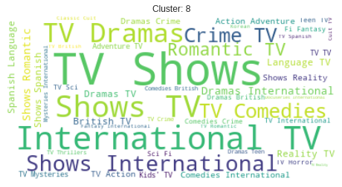
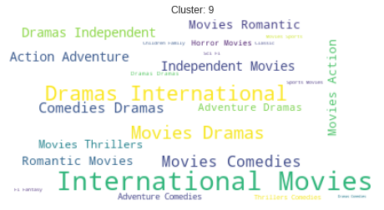
Cluster 8: International TV Shows. Cluster 9: Action, Adventure and Independent Movies

Slide 36
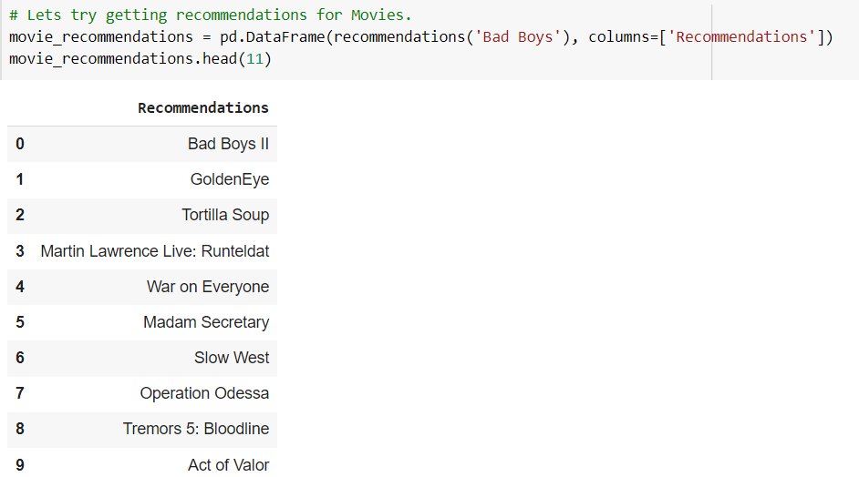
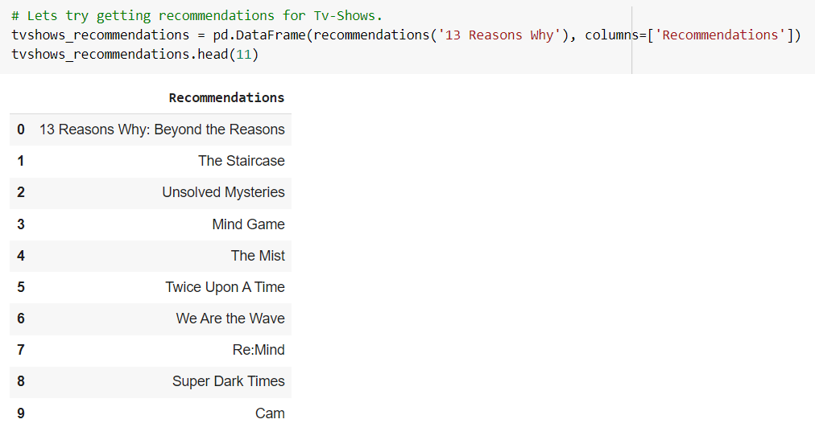
Getting Recommendations:
Movies
TV Shows
We obtained recommendations for Movies and TV Shows using Cosine similarity.

Slide 37
Conclusion:
It was interesting to find that majority of the content available on Netflix is Movies.
But in the recent years it has been focusing more on TV-Shows.
Most of these contents are released either in the year ending or the beginning.
United States and India are among the top 5 countries that produce all of the available content on the platform.
Also 6 of the actors among the top ten actors with maximum content are from India.
TV-MA tops the charts, indicating that mature content is more popular on Netflix.
k=10 was found to be an optimal value for clusters using which we grouped our data into 10 distinct clusters.
Using the given data, a simple recommender system was created using cosine_similarity and recommendations for Movies and TV Shows were obtained.
Future Scope:
Integrating this dataset with other external datasets such as IMDB ratings, rotten tomatoes can also provide many interesting findings.
More time could be given into building a better recommender system, which later can be deployed on web for usage.

Slide 38



